Slide 1
☁
AWS SERVICE EXPLORER
An Interactive Web Application for Exploring AWS Cloud Services
Sahil Sharma | Roll-2410030764 | B.Tech CSE, IILM University, Greater Noida
AICTE–EduSkills Virtual Internship Program — AWS Cloud Business Application

Slide 2
Introduction
☁
A simple web-based application for exploring AWS cloud services
Developed using Python and Streamlit
Helps users understand service features, categories, and business use cases
Offers an easy, interactive interface — no complex AWS setup required
Built with Python
+ Streamlit
AWS Service Explorer
2

Slide 3
Problem Statement
AWS offers a large number of cloud services — making it difficult for beginners to understand, navigate, and compare them.
❓
⚖
🔍
Confusing choices
Hard to compare
Info overload
Beginners struggle to identify each service's purpose
No easy way to see features side by side
Official docs are dense and technical
AWS Service Explorer
3

Slide 4
Project Objectives
Develop a simple web application for exploring AWS services
Provide basic information about selected AWS services
1
2
Display key features and business applications
Allow users to search AWS services by name or category
3
4
Provide a simple comparison between two AWS services
Create an easy-to-use learning interface for beginners
5
6
AWS Service Explorer
4

Slide 5
Technologies & Tools Used
🐍
⚡
💻
Python
Streamlit
VS Code
Main programming language
Web application interface
Development environment
📁
🔗
Python Dictionary
GitHub
Stores AWS service information
Version control & hosting
No paid AWS services required for the current version.
AWS Service Explorer
5

Slide 6
System Architecture
👤
🖥
🔍
☁
⚙
📊
User
Streamlit Web Interface
Search / Selection
AWS Service Information
Processing & Filtering
Service Details / Comparison
Data flows from the user through the Streamlit interface, is filtered against the stored AWS service data, and results are returned to the user.
AWS Service Explorer
6

Slide 7
Features & Working
🔍
Explore Services
⚖
Compare Services
Browse all 8 AWS services with descriptions, categories, key features, and business applications
Select two services and view a side-by-side comparison table
📊
Dashboard Metrics
ℹ
About Project
Quick view of total services, categories, and application type
Project description, objectives, technologies, and scope
AWS Service Explorer
7

Slide 8
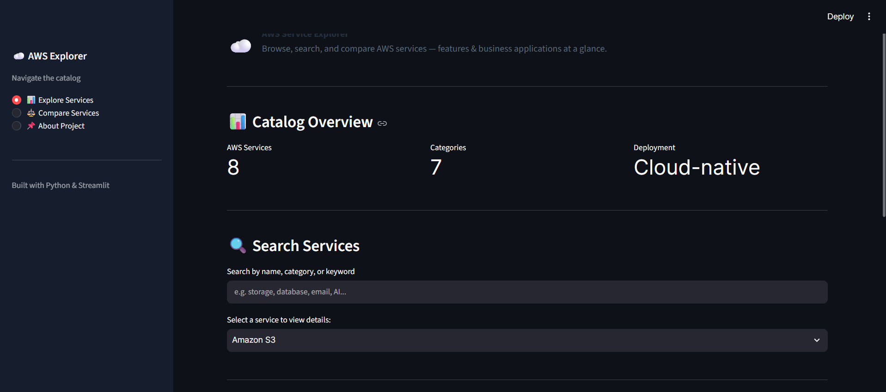
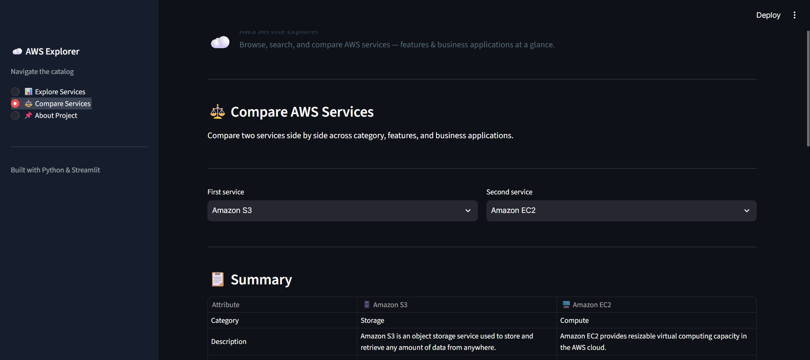
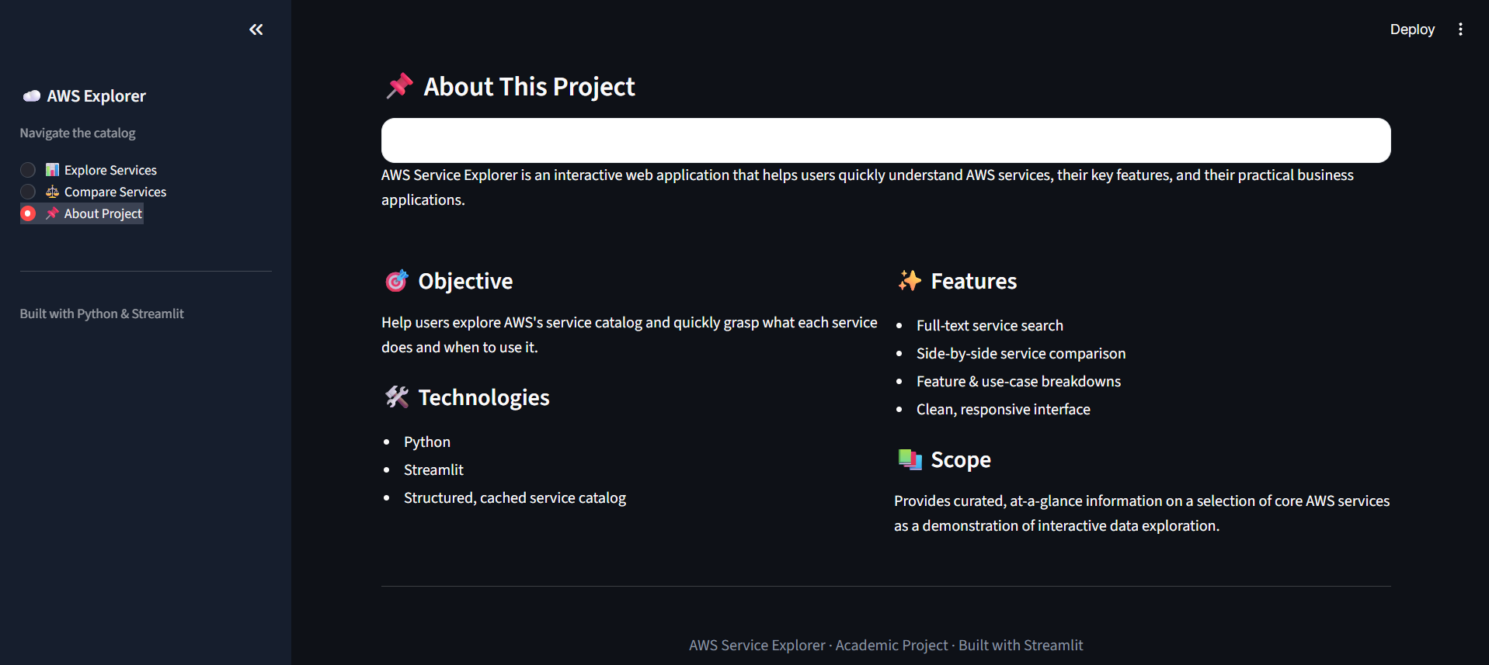
Screenshots / Demo
Replace the placeholders below with real screenshots of Explore, Compare, and About pages before presenting.
🖼
🖼
🖼
[ Explore Services screenshot ]
[ Compare Services screenshot ]
[ About Project screenshot ]
Explore Services
Compare Services
About Project
AWS Service Explorer
8

Slide 9
Expected Outcomes
Helps beginners understand AWS services easily
Provides organized, easy-to-read service information
Allows users to search and compare services quickly
Demonstrates practical use of Python and Streamlit
Builds a basic understanding of AWS services and their business applications
AWS Service Explorer
9

Slide 10
Conclusion
AWS Service Explorer successfully provides a simple, interactive way for beginners to learn about AWS cloud services. Built using Python and Streamlit, it demonstrates practical application development skills gained during the AWS Cloud Business Application internship, while keeping the implementation easy to build, explain, and extend.
☁
Future Scope
Connect to real AWS APIs • Add more services • Provide live cloud information
Thank You
AWS Service Explorer
10

